Slide 1
Undersmoothed HAL-based plugin estimator for direct/indirect effects
Develop and test undersmoothed HAL-based plugin estimator for direct/indirect effects, or other more complex parameters.
Seraphina

Slide 2


Controlled direct effects
Data structure:
W: baseline, continuous
A: treatment dosage, continuous, bounded
Z: intermediate curve, binary
Y: outcome, binary
Causal target parameter:
Dose response curve

Slide 3
Controlled direct effects - simulations
Generate data with given sample size n with the given DGD
Fitting the Y ~ X directly with undersmoothed HAL using the sample once
max_degree = 3
smoothness_orders = 1
base_num_knots_0 = 20
base_num_knots_1 = 20
Estimating the targeted parameter by calculating the simple substitution estimator
Predicting given a and z
using the fitted undersmoothed HAL for all combinations of a and z

Slide 4
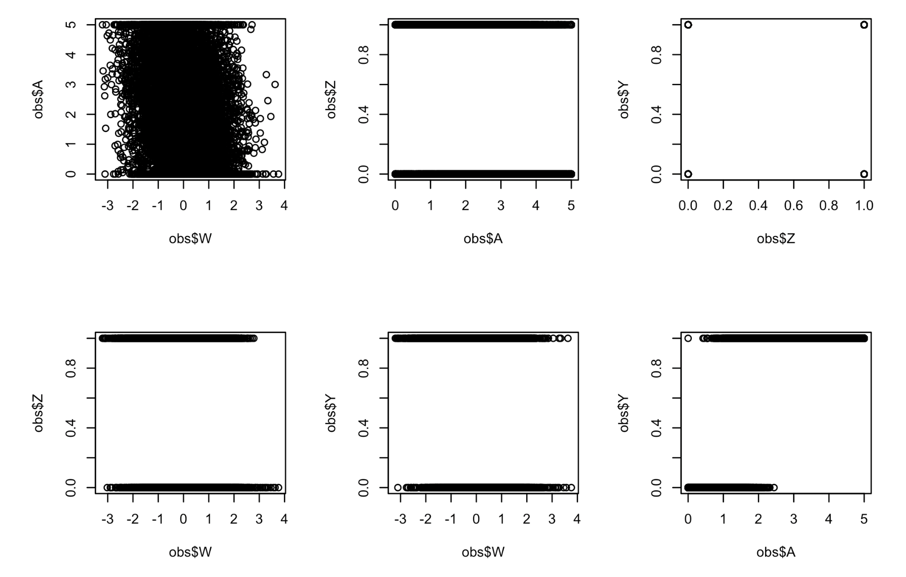
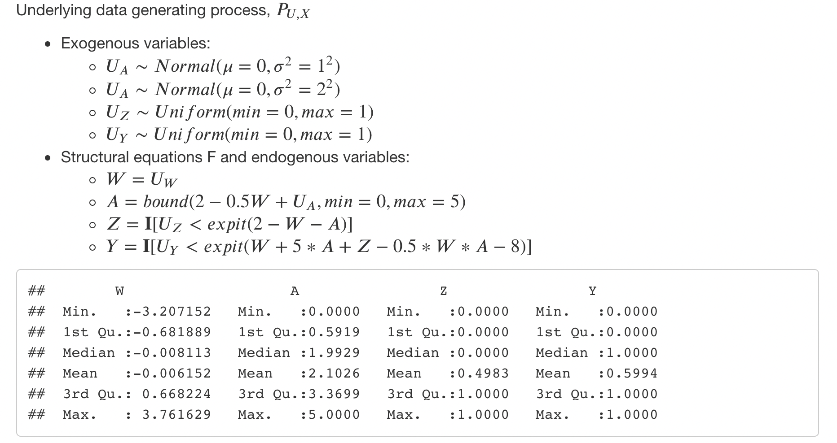
Simulation #1

Slide 5
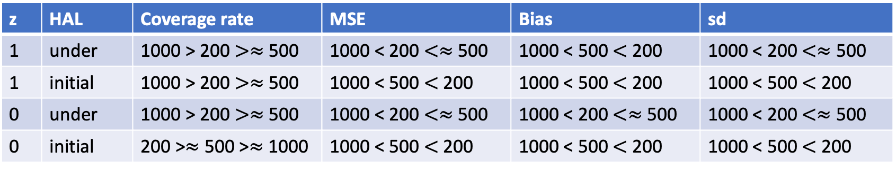
Simulation #1 – Results summary
n | z | Coverage rate | MSE | Bias | sd
200 | 1 | Under > Initial | Initial < Under | Initial < Under | Initial < Under
200 | 0 | Under > Initial | Initial < Under | Initial < Under | Initial < Under
500 | 1 | Under > Initial | Initial < Under | Initial < Under | Initial < Under
500 | 0 | Under > Initial | Initial < Under | Initial < Under | Initial < Under
1000 | 1 | Under > Initial | Initial < Under | Initial < Under | Initial < Under
1000 | 0 | Under > Initial | Initial < Under | Initial < Under | Initial < Under
Compare between sample sizes:
z | HAL | Coverage rate | MSE | Bias | sd
1 | under | 1000 > 200 $>≈$ 500 | 1000 < 200 $<≈$ 500 | 1000 < 500 $<$ 200 | 1000 < 200 $<≈$ 500
1 | initial | 1000 > 200 $>≈$ 500 | 1000 < 500 $<$ 200 | 1000 < 500 $<$ 200 | 1000 < 500 $<$ 200
0 | under | 1000 > 200 $>≈$ 500 | 1000 < 200 $<≈$ 500 | 1000 < 200 $<≈$ 500 | 1000 < 200 $<≈$ 500
0 | initial | 200 >$≈$ 500 >$≈$ 1000 | 1000 < 500 $<$ 200 | 1000 < 500 $<$ 200 | 1000 < 500 $<$ 200
Estimations performed better when z = 1 almost for all a’s

Slide 6
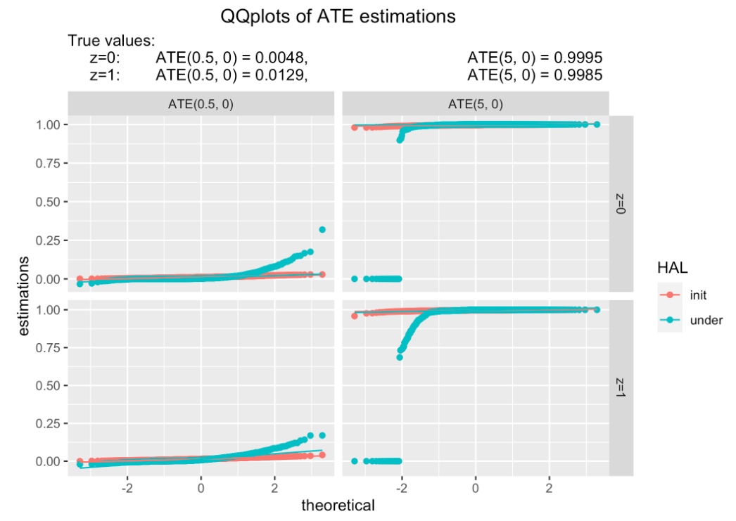
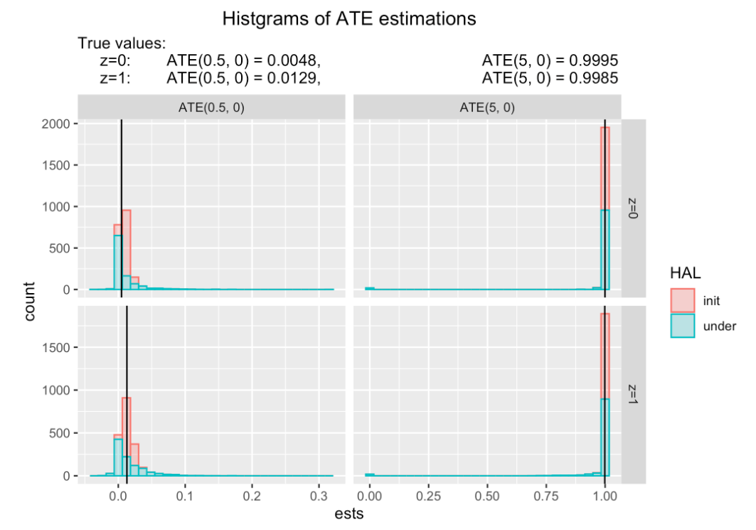
Prediction distribution visualizations
n = 1000, B = 1000
Notes:
N = 200, try n = 1000
N -> 2000
Asymtopically non-linear?
Sampling distributions + qq plot
Undersmooth too Much?
Different way to undersmooth?
-> more empirical? Not max, but plate
->

Slide 7
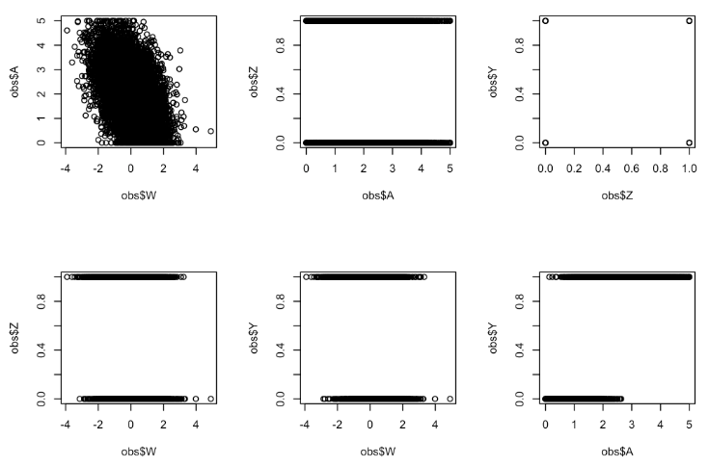
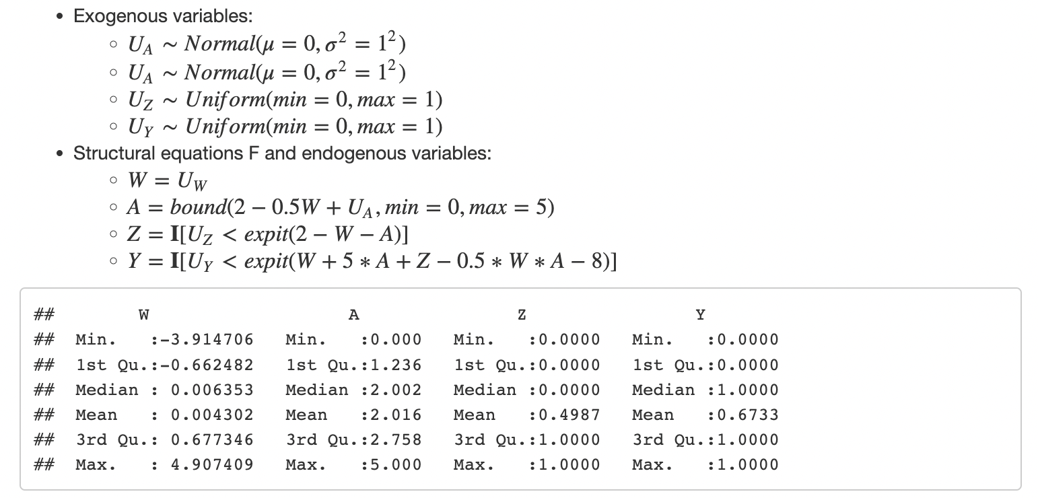
Simulation #1-1

Slide 8
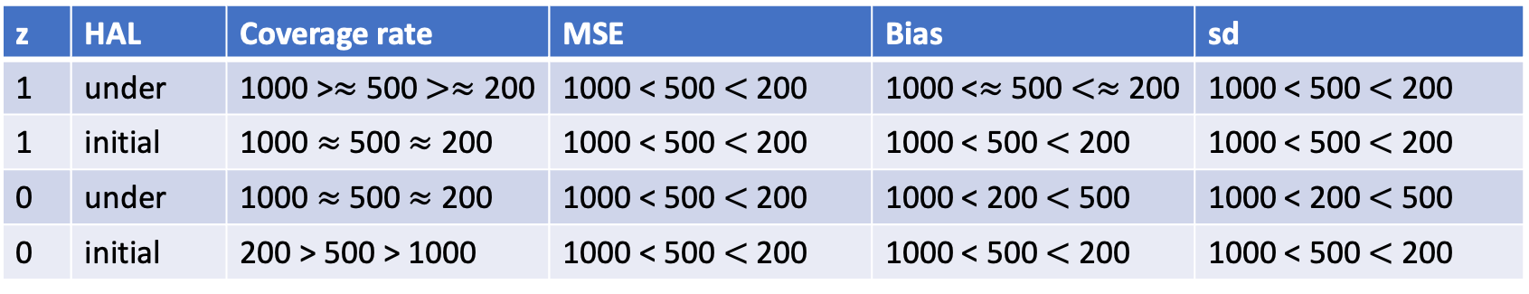
Simulation #1-1 – Results summary
n | z | Coverage rate | MSE | Bias | sd
200 | 1 | Under > Initial | Initial < Under | Initial < Under | Initial < Under
200 | 0 | Under > Initial | Initial < Under | Initial < Under | Initial < Under
500 | 1 | Under > Initial | Initial < Under | Initial < Under | Initial < Under
500 | 0 | Under > Initial | Initial < Under | Initial < Under | Initial < Under
1000 | 1 | Under > Initial | Initial < Under | Initial < Under | Initial < Under
1000 | 0 | Under > Initial | Initial < Under | Initial < Under | Initial < Under
z | HAL | Coverage rate | MSE | Bias | sd
1 | under | 1000 >$≈$ 500 $>≈$ 200 | 1000 < 500 $<$ 200 | 1000 <$≈$ 500 $<≈$ 200 | 1000 < 500 $<$ 200
1 | initial | 1000 $≈$ 500 $≈$ 200 | 1000 < 500 $<$ 200 | 1000 < 500 $<$ 200 | 1000 < 500 $<$ 200
0 | under | 1000 $≈$ 500 $≈$ 200 | 1000 < 500 $<$ 200 | 1000 < 200 $<$ 500 | 1000 < 200 $<$ 500
0 | initial | 200 > 500 > 1000 | 1000 < 500 $<$ 200 | 1000 < 500 $<$ 200 | 1000 < 500 $<$ 200
Estimations performed better when z = 1 almost for all a’s

Slide 9

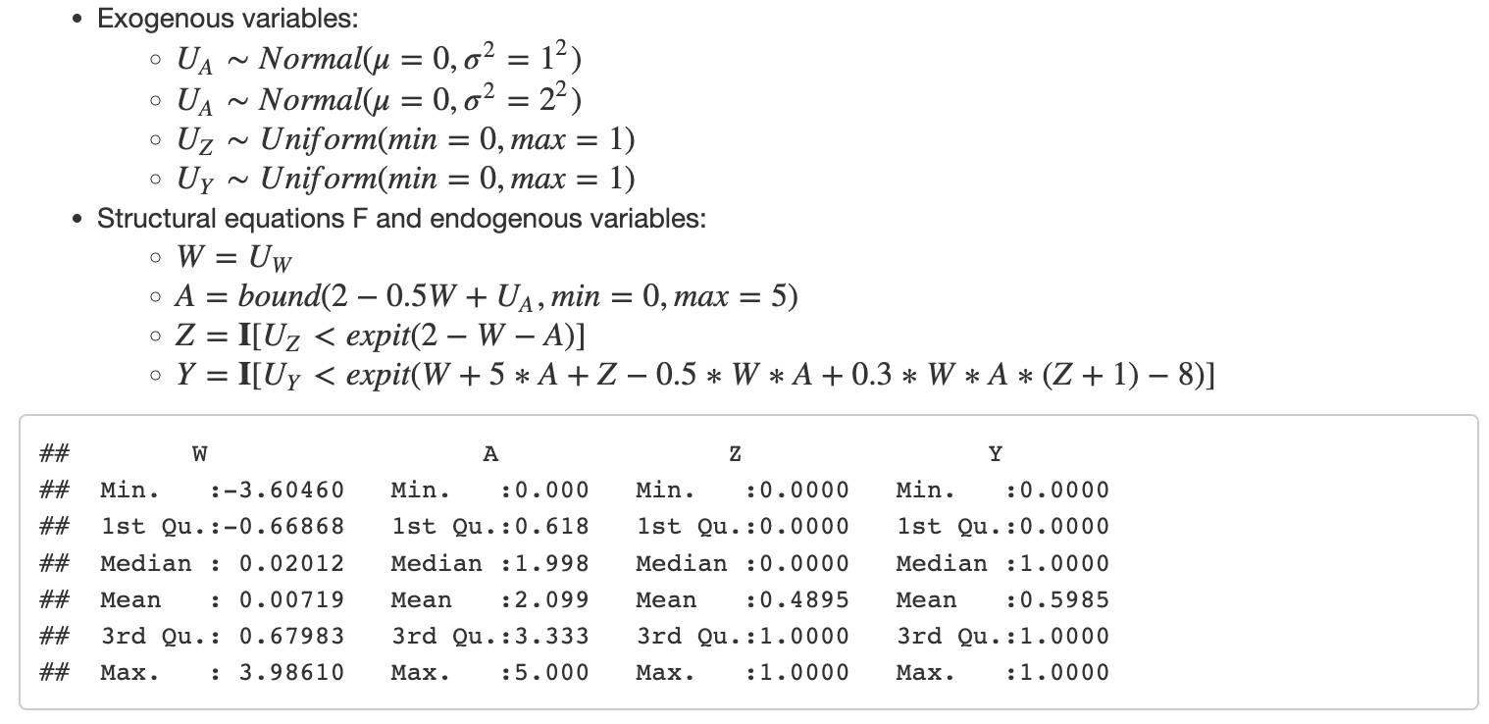
Simulation #1-2

Slide 10
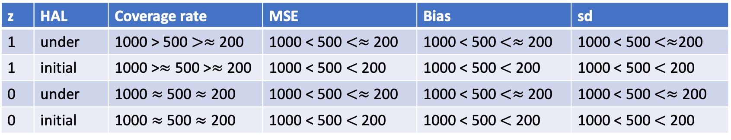
Simulation #1-2 – Results summary
n | z | Coverage rate | MSE | Bias | sd
200 | 1 | Under > Initial | Initial < Under | Initial < Under | Initial < Under
200 | 0 | Under > Initial | Initial < Under | Initial < Under | Initial < Under
500 | 1 | Under > Initial | Initial < Under | Initial < Under | Initial < Under
500 | 0 | Under > Initial | Initial < Under | Initial < Under | Initial < Under
1000 | 1 | Under > Initial | Initial < Under | Initial < Under | Initial < Under
1000 | 0 | Under > Initial | Initial < Under | Initial < Under | Initial < Under
z | HAL | Coverage rate | MSE | Bias | sd
1 | under | 1000 > 500 $>≈$ 200 | 1000 < 500 $<≈$ 200 | 1000 < 500 $<≈$ 200 | 1000 < 500 $<≈$200
1 | initial | 1000 >$≈$ 500 >$≈$ 200 | 1000 < 500 $<$ 200 | 1000 < 500 $<$ 200 | 1000 < 500 $<$ 200
0 | under | 1000 $≈$ 500 $≈$ 200 | 1000 < 500 $<≈$ 200 | 1000 < 500 $<≈$ 200 | 1000 < 500 $<≈$ 200
0 | initial | 1000 $≈$ 500 $≈$ 200 | 1000 < 500 $<$ 200 | 1000 < 500 $<$ 200 | 1000 < 500 $<$ 200
Estimations performed better when z = 1 almost for all a’s

Slide 11
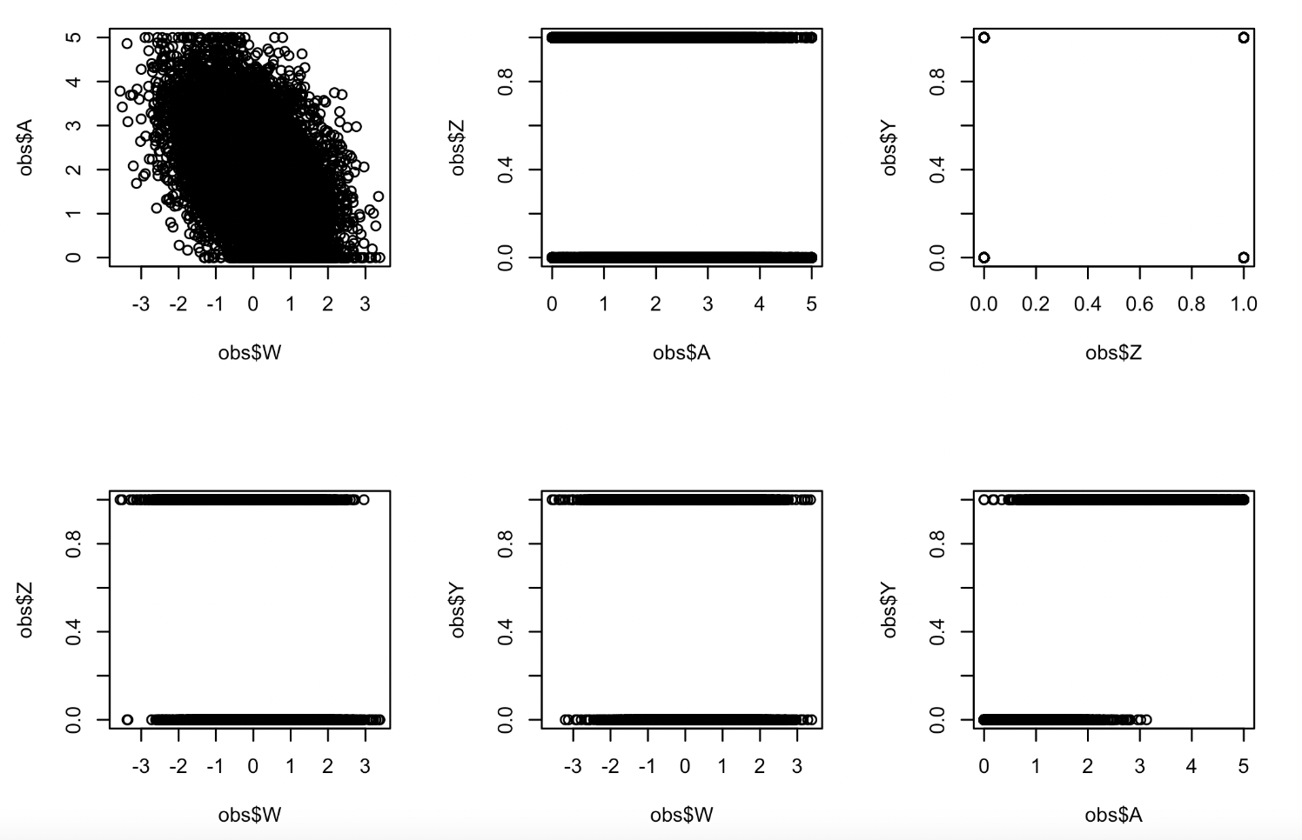
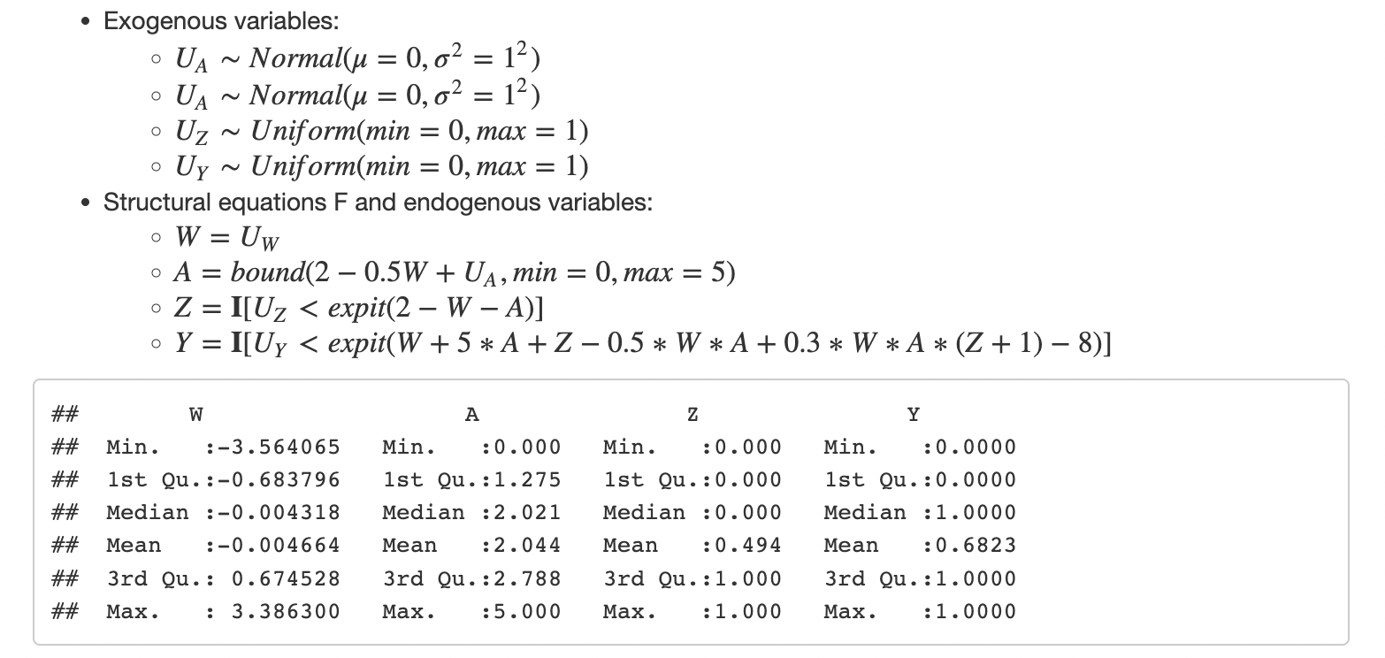
Simulation #1-3

Slide 12
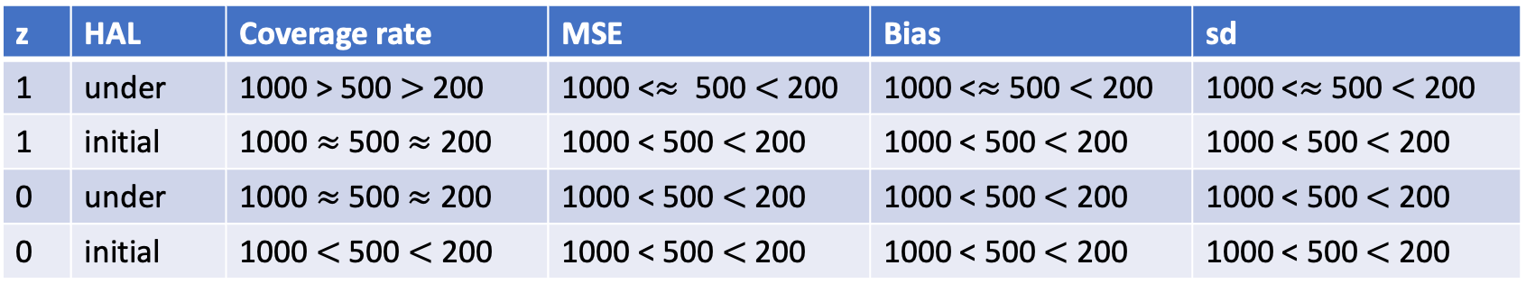
Simulation #1-3 – Results summary
n | z | Coverage rate | MSE | Bias | sd
200 | 1 | Under > Initial | Initial < Under | Initial < Under | Initial < Under
200 | 0 | Under > Initial | Initial < Under | Initial < Under | Initial < Under
500 | 1 | Under > Initial | Initial < Under | Initial < Under | Initial < Under
500 | 0 | Under > Initial | Initial < Under | Initial < Under | Initial < Under
1000 | 1 | Under > Initial | Initial < Under | Initial < Under | Initial < Under
1000 | 0 | Under > Initial | Initial < Under | Initial < Under | Initial < Under
z | HAL | Coverage rate | MSE | Bias | sd
1 | under | 1000 > 500 $>$ 200 | 1000 <$≈$ 500 $<$200 | 1000 <$≈$ 500 $<$ 200 | 1000 <$≈$ 500 $<$ 200
1 | initial | 1000 $≈$ 500 $≈$ 200 | 1000 < 500 $<$ 200 | 1000 < 500 $<$ 200 | 1000 < 500 $<$ 200
0 | under | 1000 $≈$ 500 $≈$ 200 | 1000 < 500 $<$ 200 | 1000 < 500 $<$ 200 | 1000 < 500 $<$ 200
0 | initial | 1000 $<$ 500 $<$ 200 | 1000 < 500 $<$ 200 | 1000 < 500 $<$ 200 | 1000 < 500 $<$ 200
Estimations performed better when z = 1 almost for all a’s

Slide 13
Simulation #1: compare v0, v1, v2, and v3
v0
v1
v2
v3
Positivity violation
3-way interactions
Positivity violation
3-way interactions
N = 1000:
HAL | z | Coverage rate | MSE | Bias | sd
Under | 1 | similar | v1, v3 < v0, v2 | v1, v3 < v0, v2 | v1, v3 < v0, v2
Initial | 1 | v0 > v2 > v1, v3 | v0 < v2 < v3 < v1 | v0, v2 < v1, v3 | v0, v2 < v1, v3
Under | 0 | v0 > v2 > v3 > v1 | v1 < v3 < v2 < v0 | v1, v3 < v0, v2 | v1 < v3 < v2 < v0
Initial | 0 | similar | v0 < v2 < v3 < v1 | v2 < v0 < v1 < v3 | v0, v2 < v1, v3
Notes:
QQ plot of the initial vs undersmoothed pick one value one simulation where estimation do poorly

Slide 14
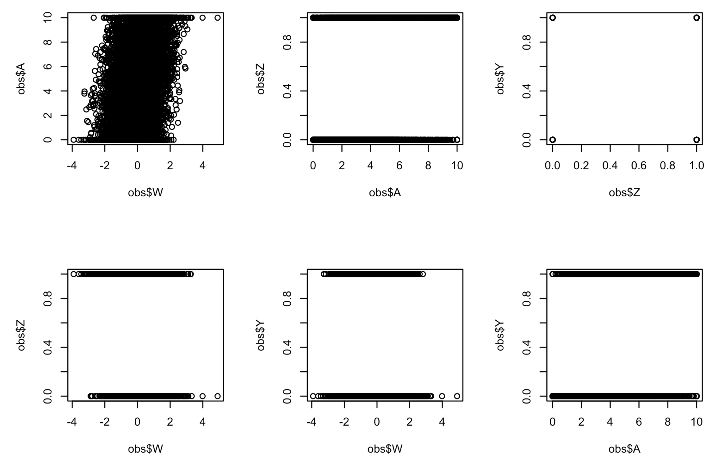
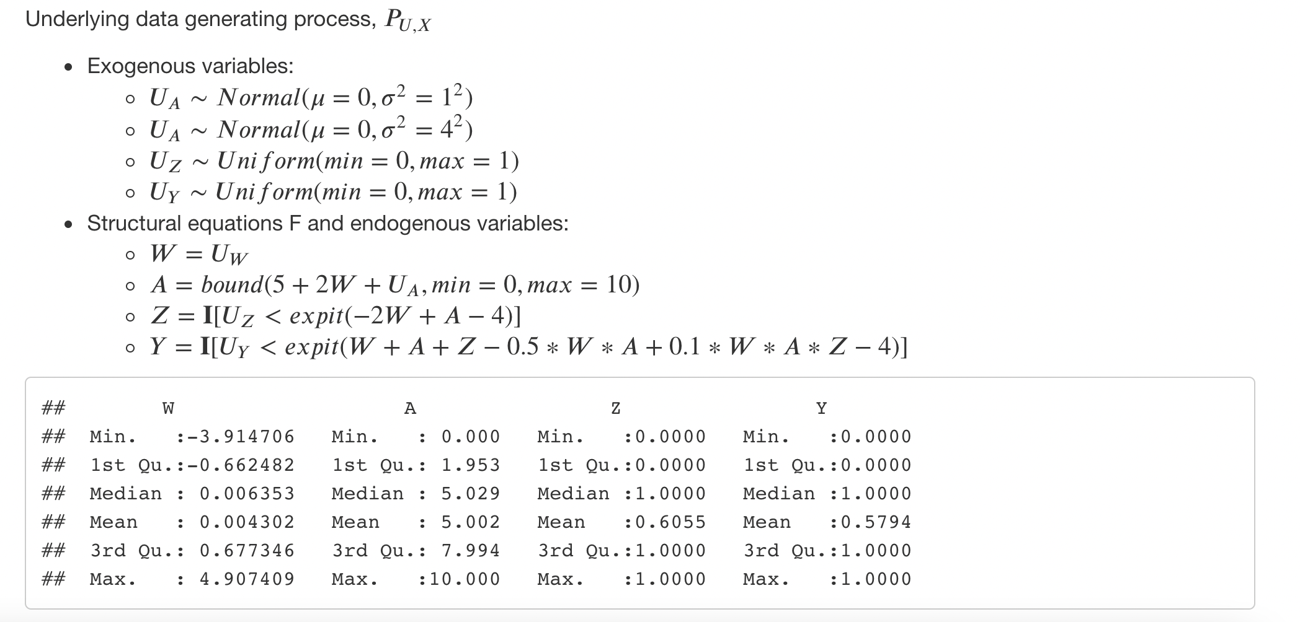
Simulation #2

Slide 15
Simulation #2 – Results summary
n | z | Coverage rate | MSE | Bias | sd
200 | 1
200 | 0
500 | 1
500 | 0
1000 | 1
1000 | 0
z | HAL | Coverage rate | MSE | Bias | sd
1 | under
1 | initial
0 | under
0 | initial
Estimations performed better when z = 1 almost for all a’s

Slide 16
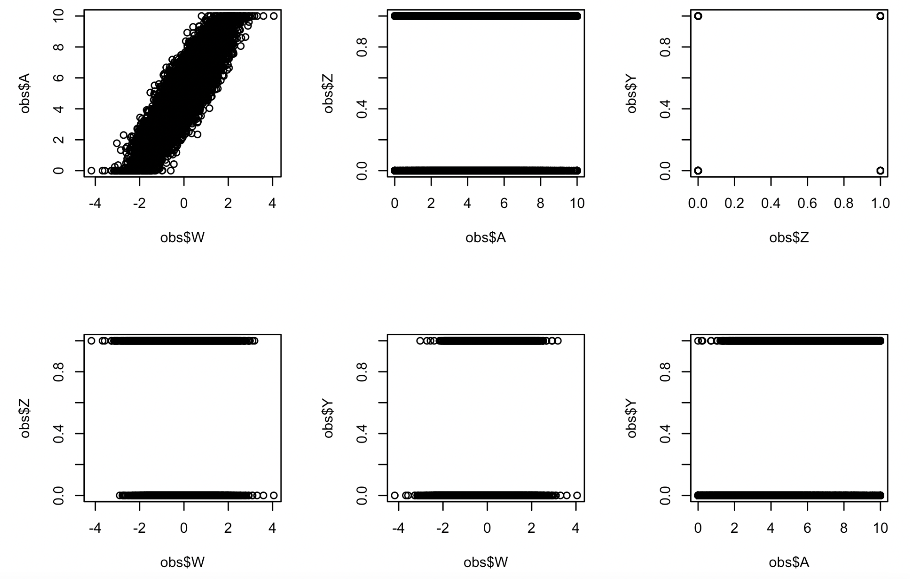
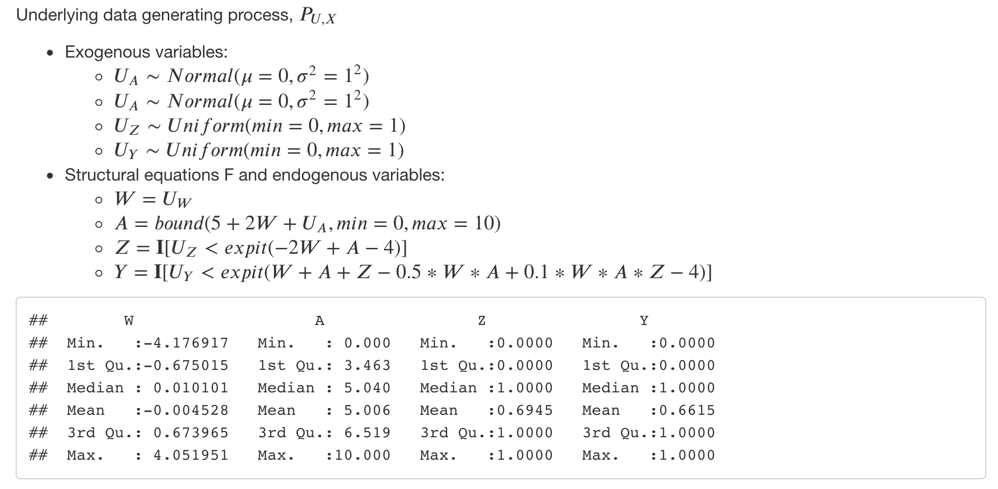
Simulation #3

Slide 17
Simulation #3 – Results summary
n | z | Coverage rate | MSE | Bias | sd
200 | 1
200 | 0
500 | 1
500 | 0
1000 | 1
1000 | 0
z | HAL | Coverage rate | MSE | Bias | sd
1 | under
1 | initial
0 | under
0 | initial
Estimations performed better when z = 1 almost for all a’s

Slide 18
TODO:
Are we over undersmoothing?
How to tune undersmoothed HAL to outperform initial HAL in general?
Data adaptively tune he hyperparameters for fitting (undersmoothed) HAL?
How to construct non-oracle CI?
More simulations
Think about DGDs needed to be simulated
Think of a real data example with continuous A and binary Z to do causal inference with under-smoothed HAL.

